Slide 1
The Processor: Datapath and Control
Chapter - 4

Slide 2
Introduction
A subset of the core MIPS instruction set:
The memory-reference instruction – lw, sw
The arithmetic-logical instruction – add, sub, and, or, slt
The branch instructions - branch equal (beq), jump (j)

Slide 3
An overview of the implementation
For every instruction, the first two steps are identical:
Sent the PC to the memory that contains the code and fetch the instruction from that memory.
Read one or two registers, using fields of the instruction to select the registers to read. For the load word instruction, we need to read only one register, but most other instruction require two registers.

Slide 4
An overview of the implementation (Cont.)
Even across different instruction classes there are some similarities: Example
All instruction classes use the ALU after reading the registers.
  Memory-reference – address calculation
  Arithmetic-logic – operation execution
  Branch – comparison.

Slide 5
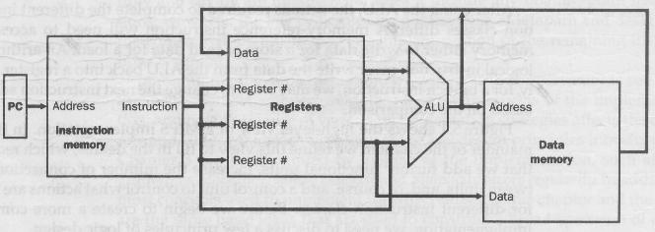
An overview of the implementation (Cont.)
Fig. – An abstract view of the implementation.

Slide 6
Clocking Methodology
A clocking methodology defines when signal can be read and when they can be written.
If a signal is written at the same time it is read, the value of the read could correspond to the old value, the newly written value, or even some mix of two → clocking methodology prevents this circumstances
We assume edge-triggered clocking.
Any values stored in the machine are updated only on a clock edge.

Slide 7
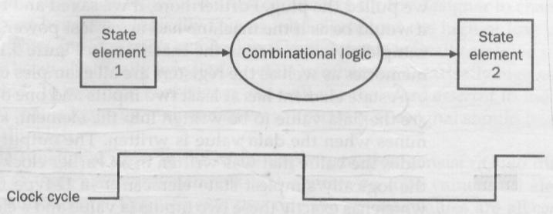
Clocking Methodology (Cont.)
Combinational logic, which operate in a single clock cycle.

Slide 8
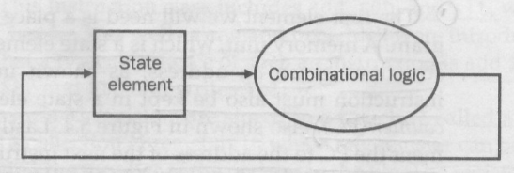
Clocking Methodology (Cont.)
An edge triggered methodology allows us to read the contents of a register, send the value through some combinational logic, and write the register in the same clock cycle.
Designs in this chapter and the next rely on the edge-triggered timing methodology.

Slide 9
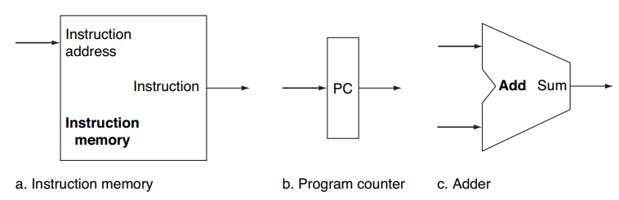
Building a Datapath
Fetching Instructions
Instruction memory (IM) and PC are state elements.
IM is used to hold and supply instruction given an address
PC keeps the address of the instructions.
An adder to increment the PC to the address of the next instruction

Slide 10
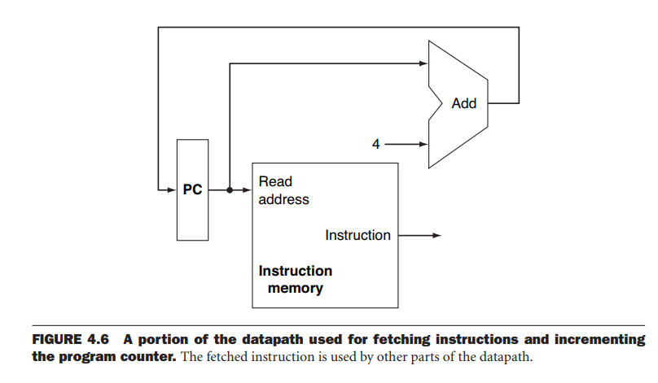
Building a Datapath(cont.)

Slide 11
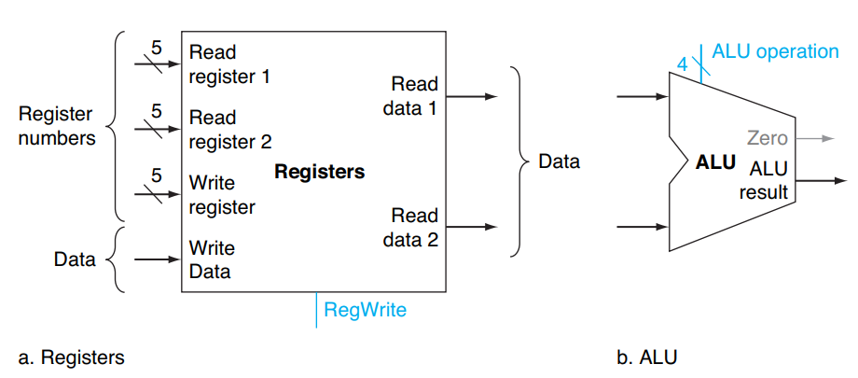
Building a Datapath(cont.)
Arithmetic-logical Instructions
add $t1, $t2, $t3

Slide 12
Building a Datapath(cont.)
Arithmetic logical operations:
The register file contains all the registers and has two read ports and one write ports.
Register file always outputs the contents of whatever register numbers are on the read registers inputs.
Write is controlled by the write control signal
We need total four inputs (three for register number and one for data)
ALU is controlled with the ALU operation signal which is 32 bit wide.

Slide 13
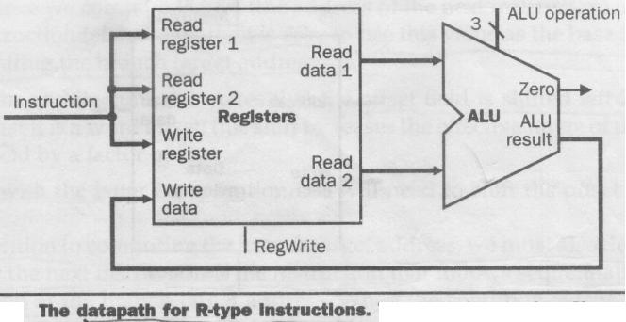
Building a Datapath(cont.)
Arithmetic-logical Instructions
add $t1, $t2, $t3

Slide 14
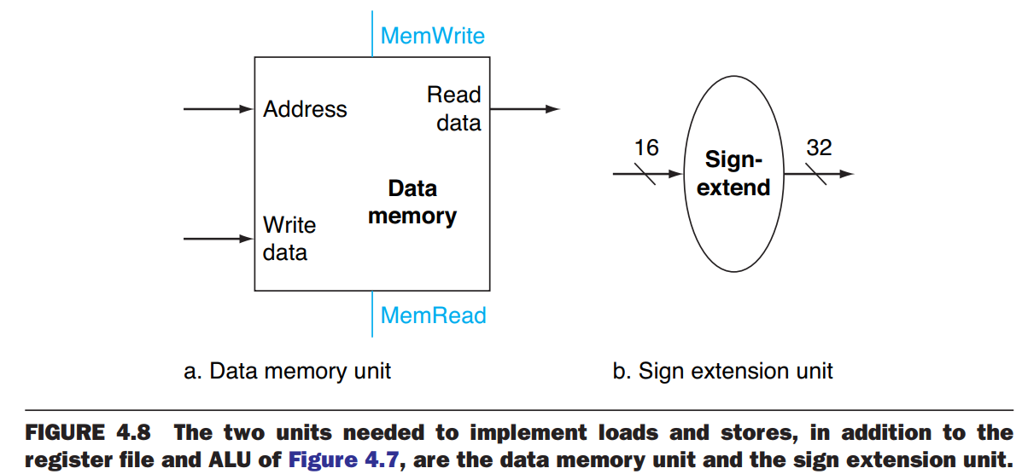
Building a Datapath (cont.)
Load word / Store word
lw $s1, 100 ($s2)

Slide 15
Building a Datapath (cont.)
Load/store word:
The memory unit is a state element with inputs for the address and write data, having a single output for the read result
Separate read and write control signal
The sign-extension unit has a 16-bit input that is sign extended into a 32-bit result appearing on the output

Slide 16
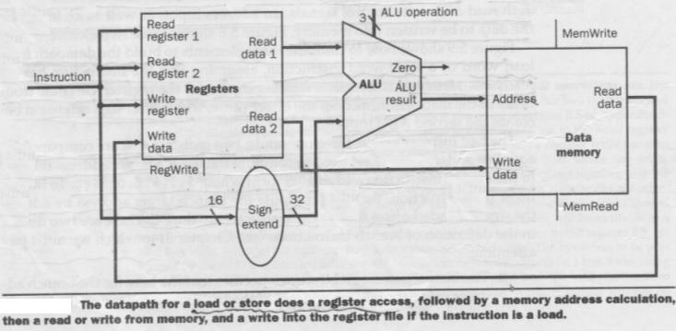
Building a Datapath (cont.)
Load: read memory and update register
Store: write register value to memory
lw $s1, 100 ($s2)

Slide 17

Building a datapath
Branch Instructions
beq $t1, $t2, offset
Details of branch instructions:
  It has three operands , two registers that are compared for equality and a 16 bit offset used to compute the branch target address.
  Branch target address = sign extended offset field + PC
  To compute the branch target address the branch datapath includes- 1. a sign extension and 2. adder
  The offset field is shifted left 2 bits.

Slide 18
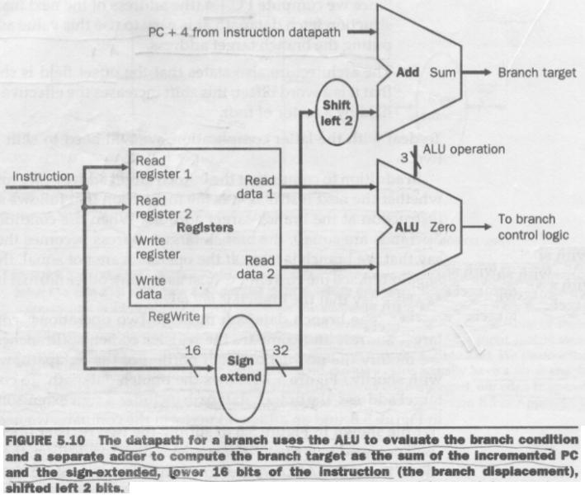
Building a Datapath (Cont.)

Slide 19
Building a datapath
This covers:
  lw, sw, beq, add, sub, and, or, slt
Creating a Single Datapath
  Single cycle implementation
  No datapath resource can be used more than once per instruction.
  So any element needed more than once must be duplicated (instruction memory and data memory are separate)
  To share a datapath element we need multiplexer / data selector.

Slide 20
A Simple Implementation Scheme
Combining Datapath:

Slide 21
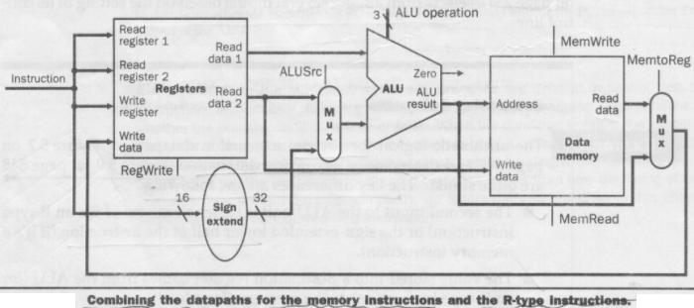
A Simple Implementation Scheme
Datapath for memory instructions and R-type instructions

Slide 22
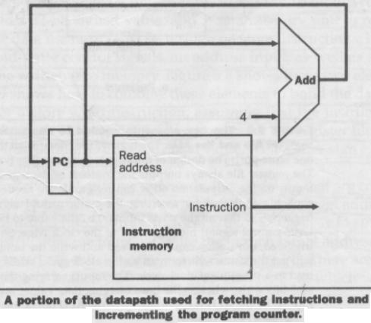
A Simple Implementation Scheme

Slide 23
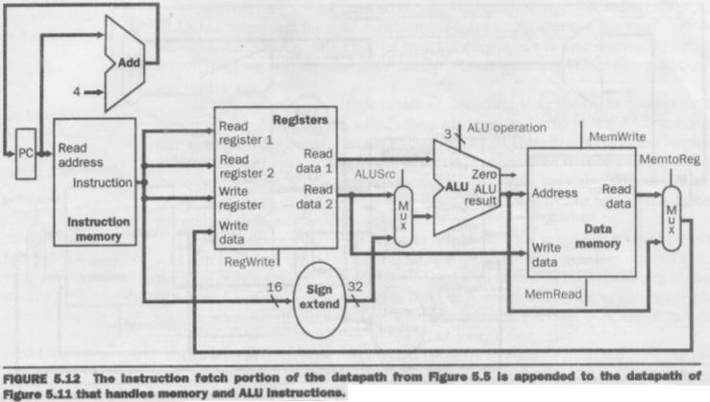
A Simple Implementation Scheme

Slide 24
A Simple Implementation Scheme

Slide 25
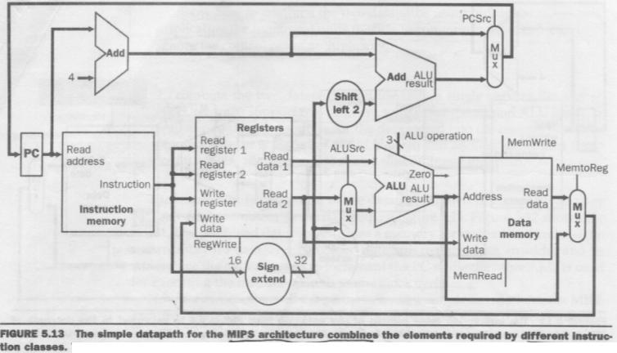
A Simple Implementation Scheme
ALU operations, load/store word and branches

Slide 26
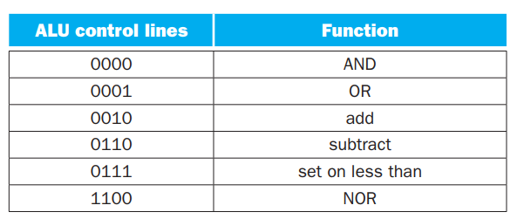
A Simple Implementation Scheme (Cont.)
The ALU Control
Depending on the instruction class, the ALU will need to perform one of these five functions.
lw, sw : compute the memory address by adding
R-type : add, sub, and, or, slt
Branch : ALU must perform a subtraction

Slide 27
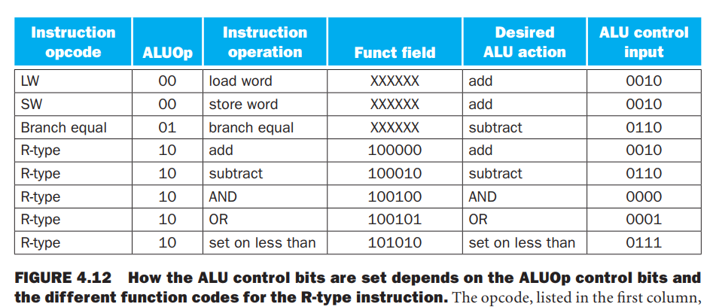
A Simple Implementation Scheme (Cont.)
The ALU Control

Slide 28

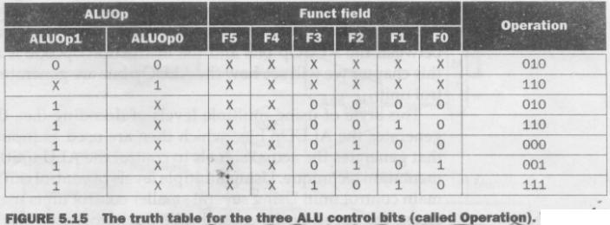
A Simple Implementation Scheme (Cont.)
The ALU Control (Truth table)
Only the entries for which the ALU control is asserted are shown.
ALUOp does not use the encoding 11, so the truth table can contain entries 1X and X1 rather than 10 and 01
When function field is used the first two bits (F5 and F4) are always 10 so they are don’t care terms.

Slide 29
A Simple Implementation Scheme (Cont.)
Designing the Main Control Unit
R-type
lw, sw
Branch
31-26 | 25-21 | 20-16 | 15-11 | 10-6 | 5-0
op | rs | rt | rd | shamt | funct
31-26 | 25-21 | 20-16 | 15-0
35 or 43 | rs | rt | address
31-26 | 25-21 | 20-16 | 15-0
4 | rs | rt | address

Slide 30
A Simple Implementation Scheme (Cont.)
Designing the Main Control Unit
Observations:
  op field always contained in bits 31-26.
  Two registers to be read are always specified at positions 25-21 and 20-16. (R-type, beq, sw)
  Base register for lw and sw is always in 25-21
  16-bit offset (beq, lw, sw) are always in 15-0
  Destination register is in 20-16 (lw) or 15-11 (R-type).

Slide 31
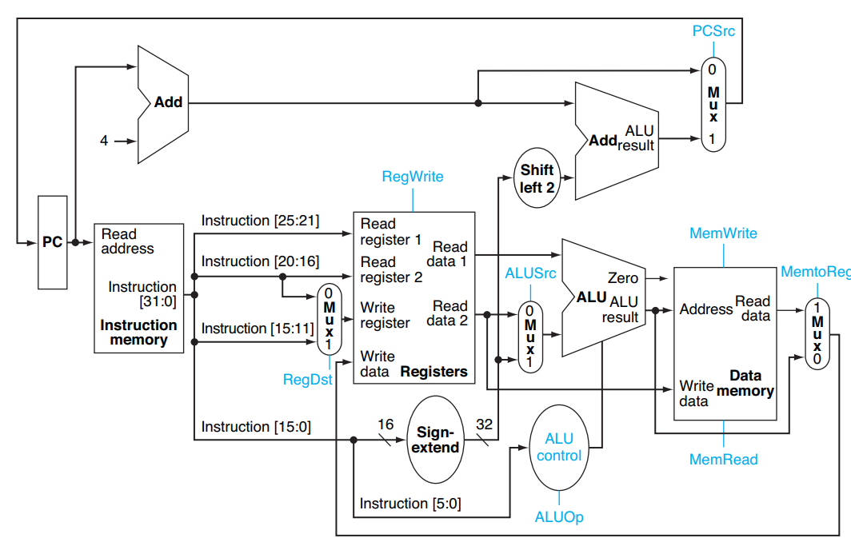
Designing the Main Control Unit
The different positions for the two destination registers implies a selector (i.e., a mux) to locate the appropriate field for each type of instruction.

Slide 32
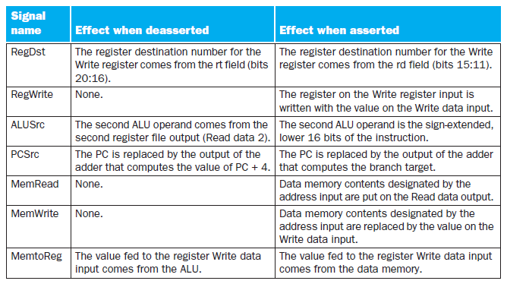
A Simple Implementation Scheme (Cont.)
The effect of each of the seven control lines

Slide 33
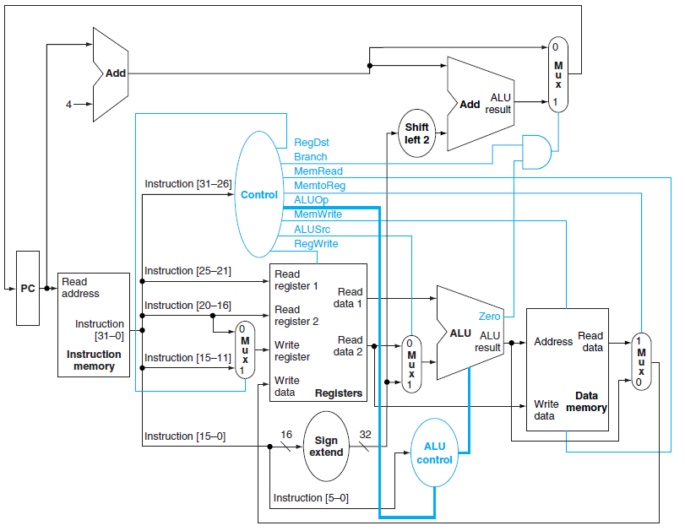
The simple datapath with the control unit

Slide 34
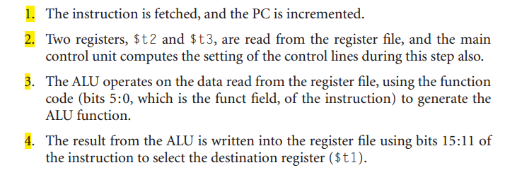
A Simple Implementation Scheme (Cont.)
Operations of the Datapath
R-type instruction ( add $t1, $t2, $t3)

Slide 35
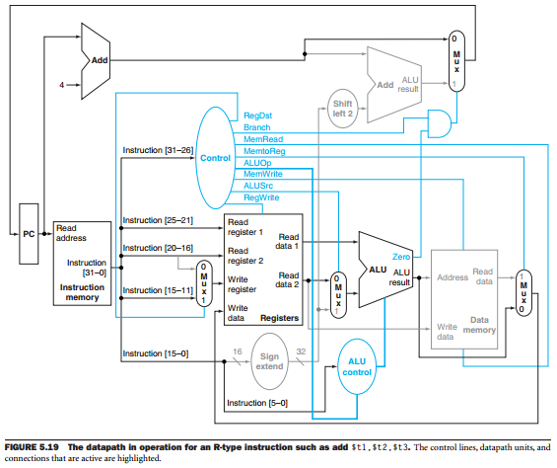
Operations of the Datapath R-type instruction ( add $t1, $t2, $t3)

Slide 36
A Simple Implementation Scheme (Cont.)
Operations of the Datapath
lw $t1, offset($t2) instruction
  Instruction is fetched
  $t2 value is read
  ALU operates
  Sum of the ALU is used as the address for the data memory
  Data from the memory is written into the register

Slide 37
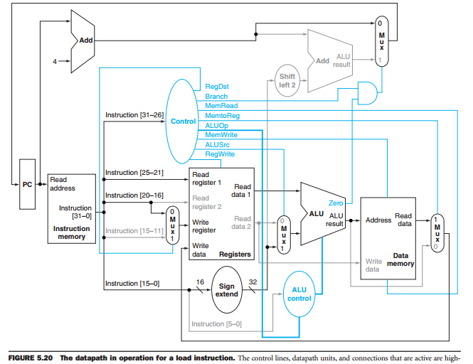
Operations of the Datapath lw $t1, offset($t2) instruction

Slide 38

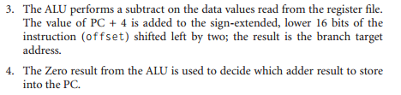
A Simple Implementation Scheme (Cont.)
Operations of the Datapath
beq $t1, $t2, offset instruction

Slide 39
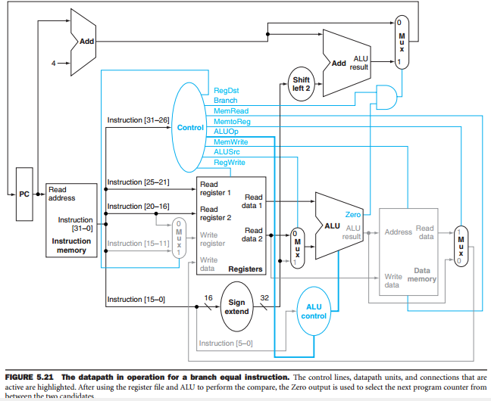
Operations of the Datapath beq $t1, $t2, offset instruction

Slide 40
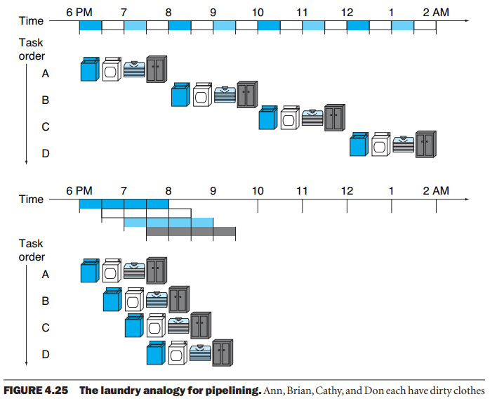

Slide 41

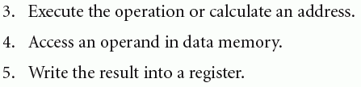

Slide 42

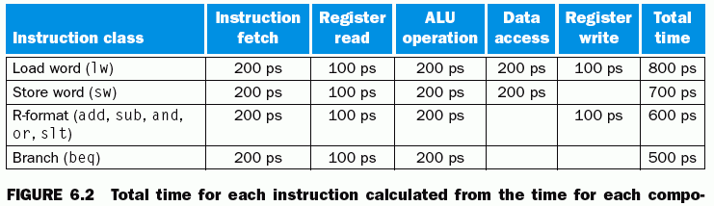

Slide 43






Slide 44
First, all MIPS instructions are the same length. This makes it easier to fetch instructions in the first pipelined stage
Second, MIPS has only a few instruction formats, with the source register fields being located in the same place in the each instruction.
Third, memory operands only appears in load or stores in MIPS. This restriction means we can use the execute stage to calculate the memory address and then access memory in the following stage
Fourth, operands must be aligned in memory.

Slide 45
Pipeline Hazards
There are situations in pipelining when the next instruction cannot execute in the following clock cycle. These events are called hazards.
Three types of hazards
  Structural hazards
    Arise from resource conflicts when the hardware can’t support all possible combinations of instructions that we want to execute in the same clock cycle. (washer dryer combination)
  Data hazards
    Arise when an instruction depends on the results of a previous instruction in a way that is exposed by overlapping of instruction in pipeline.(mate’s socks in another load).
  Control hazards
    Arise from the pipelining of branches and other instructions that change the PC (Program Counter)(we have to wait to examine washer setup until we get the 1st load from dryer)

Slide 46
Structural Hazards
If certain combination of instructions can’t be accommodated because of resource conflicts, the machine is said to have a structural hazard
It can be generated by:
  Some functional unit is not fully pipelined
  Some resources has not been duplicated enough to allow all the combinations in the pipeline to execute
  For example: a machine may have only one register file write port, but under certain conditions, the pipeline might want to perform two writes in one clock cycle – this will generate structural hazard

Slide 47
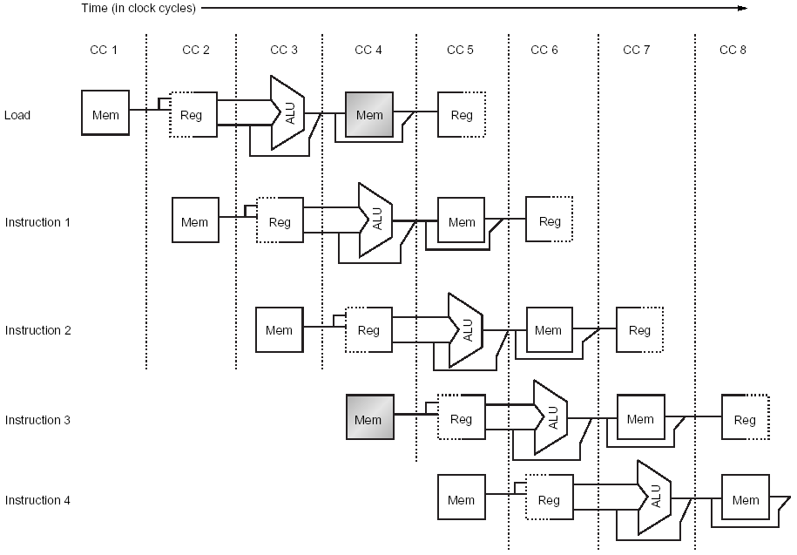
Structural Hazards(Cont)
The first instruction is accessing data from memory while the fourth instruction is fetching an instruction from that same memory.
Without two memories our pipelined could have a structural hazard

Slide 48
Data Hazards
An instruction depends on the results of a previous instruction still in the pipeline.
Consider the execution of following instructions, on our pipelined example processor:
  ADD R1, R2, R3
  SUB R4, R1, R5
  AND R6, R1, R7
  OR R8, R1, R9
  XOR R10, R1, R11

Slide 49
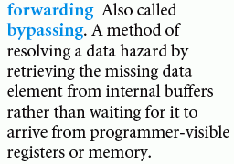
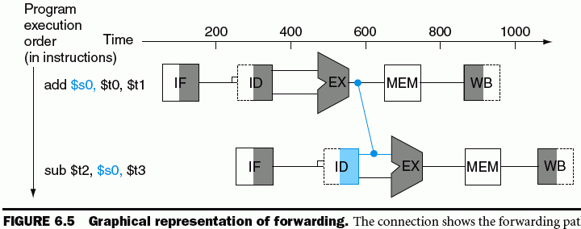
Solution of data hazard
Forwarding paths are valid if the destination stage is later in time than the source stage.
Example: forwarding of output of the memory stage to the input of the execution stage is impossible.

Slide 50
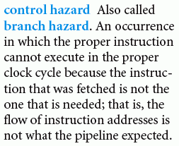
Control Hazards

Slide 51
Control Hazards
Can cause a greater performance loss than the data hazards
When a branch is executed it may or it may not change the PC (to other value than its value + 4)
  If a branch is changing the PC to its target address, than it is a taken branch
  If a branch doesn’t change the PC to its target address, than it is a not taken branch

Slide 52
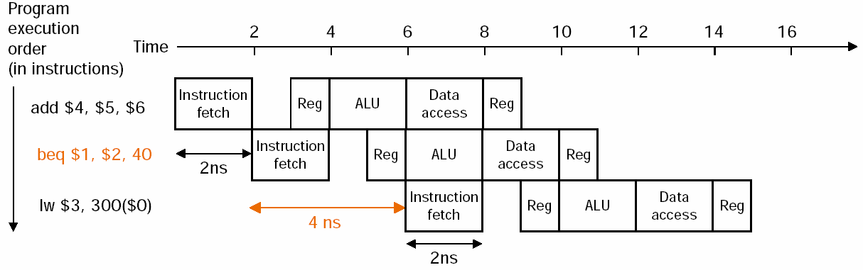
Control Hazards
Solution 1: Stall
The lw instruction executed if the branch fails, is stalled one extra 2-ns clock cycle before starting.
The cost of this option is too high for most computers.

Slide 53
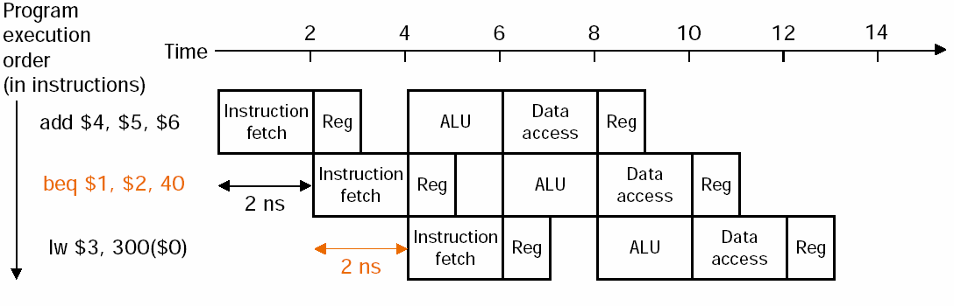
Control Hazards
Solution 2: Predict the Branch Target
One simple approach is to always predict that branch will fail. When you are right, the pipeline proceeds at full speed
Figure: when the branch is not taken

Slide 54
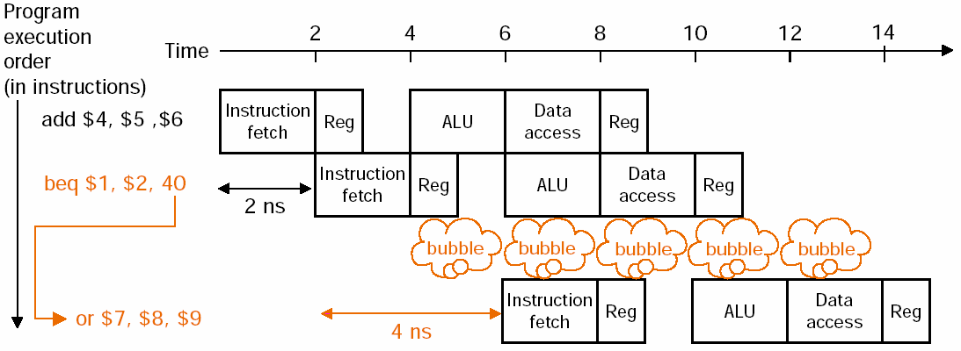
Control Hazards
Solution 2: (Mis)Predict the Branch Target

Slide 55
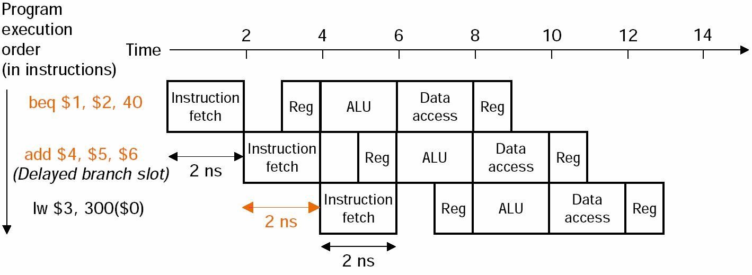
Solution 3: Delayed Decision (Used in MIPS)
Solution 3: Delayed Decision (Used in MIPS)most effective

